Slide 1
Ionic Bonding

Slide 2
What are Ions?

Slide 3
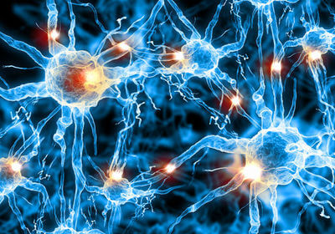
In this lesson we will be covering:
• | How many electrons can each of the electron shells in an atom hold?
• | What is an ion?
• | How does a cation form?
• | How does an anion form?
• | How do you name ions?

Slide 4
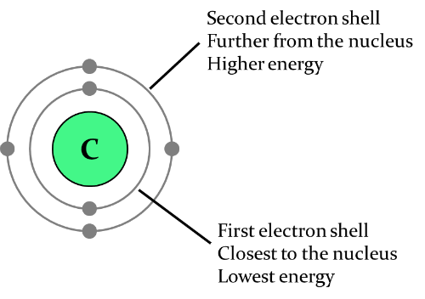
Remember that atoms have a positively charged nucleus at the centre containing protons and neutrons.
Electrons are found in orbitals (or shells) around the outside of the nucleus. The different orbitals are represented as circles at different distances from the nucleus because they have different energies.

Slide 5
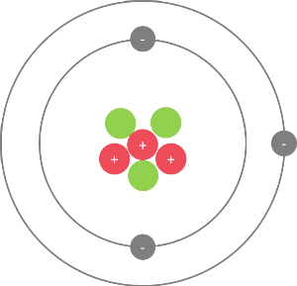
Atoms are electrically neutral (have no overall charge) because the positive charge from the protons is cancelled out by the negative charge from the electrons.
For example, the lithium atom below has 3 protons, 3 neutrons, and 3 electrons, so it has no overall charge.

Slide 6
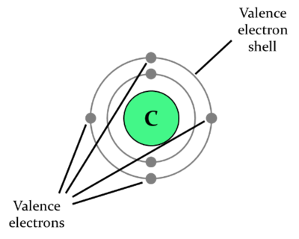
Everything in the universe is always trying to get into the lowest possible energy state, including atoms. When atoms are in a low energy state they are more stable.
For an atom to become stable, its outermost electron shell must be full. The outermost shell is called the valence shell, and the electrons in this outer shell are called valence electrons.

Slide 7
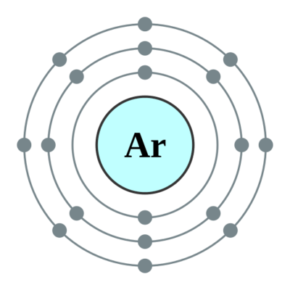
The different electron shells in an atom can hold different numbers of electrons. When the lowest energy shell is full, electrons start to fill the next lowest energy electron shell.
The first electron shell can hold up to 2 electrons.
The second electron shell can hold up to 8 electrons.
The third electron shell can hold up to 18 electrons, but it can also be stable with just 8 electrons.

Slide 8
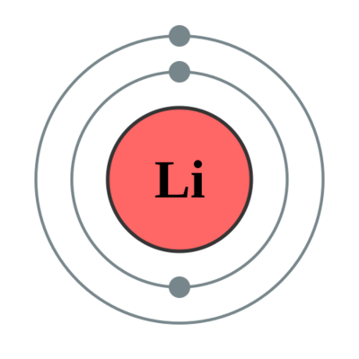
For example, lithium has 3 electrons. The first two electrons go into the first, lowest energy shell. The third electron goes into the second electron shell, which is the valence shell for lithium.

Slide 9
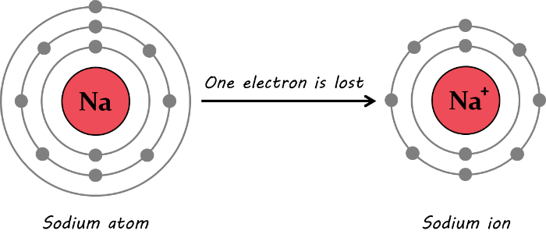
If an atom does not have a full valence shell, it will gain or lose electrons to fill the outer shell and become more stable.
When an atom gains or loses electrons, it becomes electrically charged. A charged atom is called an ion.

Slide 10
If an atom has very few electrons in its outer shell, it will lose electrons to empty the outer shell, leaving only full electron shells. The ion that is formed will have a positive charge equal to the number of electrons lost.
For example, a sodium atom has 1 electron in its valence shell, so it loses this electron to have a full valence shell. It now has one less electron than the number of protons in its nucleus, so it has a charge of +1.

Slide 11
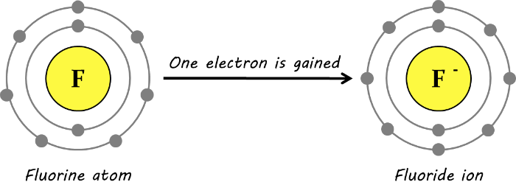
If an atom has many electrons in its outer shell, it will gain electrons to fill the outer shell. The ion that is formed will have a negative charge equal to the number of electrons gained.
For example, a fluorine atom has 7 electrons in its valence shell, so it gains one electron to have a full valence shell. It now has one more electron than the number of protons in its nucleus, so it has a charge of −1.

Slide 12

A positively charged ion is called a cation.
An easy way to remember this is that cation has a t in it - which kind of looks like a + sign, hence the positive charge!

Slide 13

A negatively charged ion is called an anion.
An easy way to remember this is that anion has an n in it and n is for negative!

Slide 14
Remember that metal atoms will lose electrons and form cations with a positive charge equal to the number of electrons lost.
Non-metal atoms will gain electrons and form anions with a negative charge equal to the number of electrons gained.

Slide 15
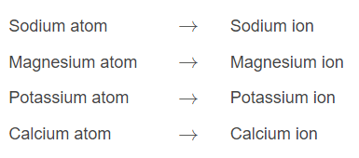
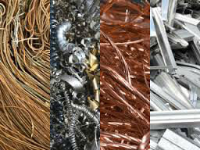
So how do we name the different types of ions?
All metal ions have the same name as their 'parent' atom. For example:

Slide 16
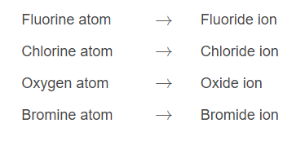
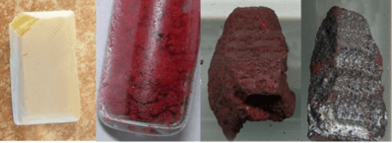
All non-metal ions have different names to their parent atom. The end of their names is replaced with -ide. For example:

Slide 17
When you are referring to an ion, you should always say ion after the name to avoid confusion. Don't just say sodium - say sodium ion!
This will let people know that you are talking about the charged ion and not the neutral atom, which will become very important as you learn about chemical reactions.

Slide 18
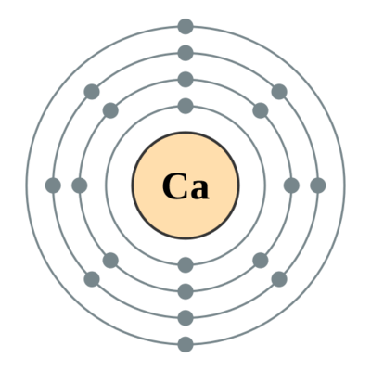
Another important thing to know is how to write the charge on an ion.
Ion symbols are written by writing the element symbol followed by the overall charge on the ion. For example, the symbol for a calcium ion is written Ca²⁺, because calcium loses two electrons to become a positively charged ion.

Slide 19
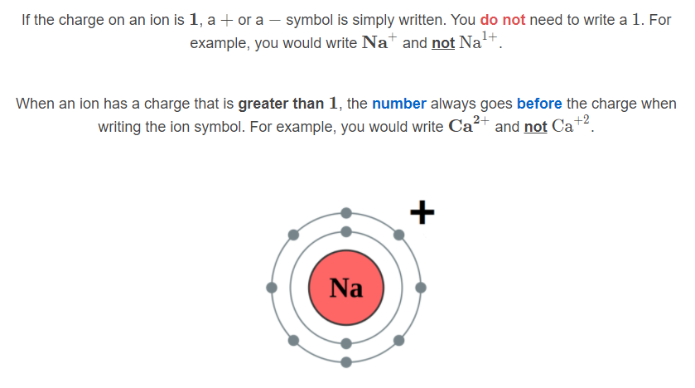

Slide 20
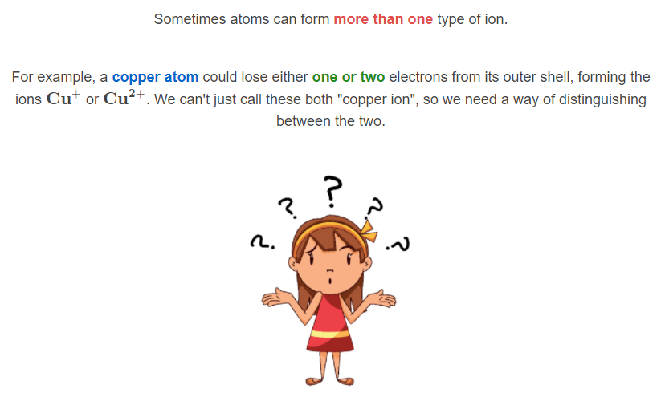

Slide 21
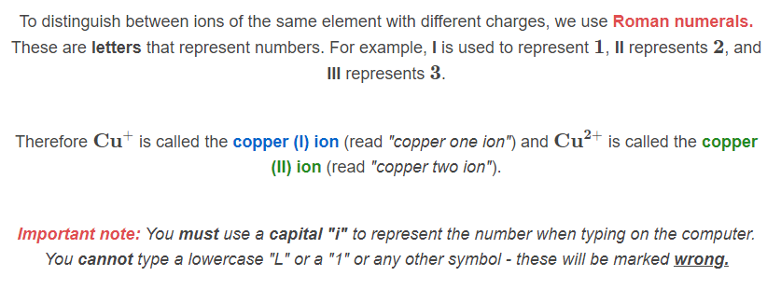

Slide 22
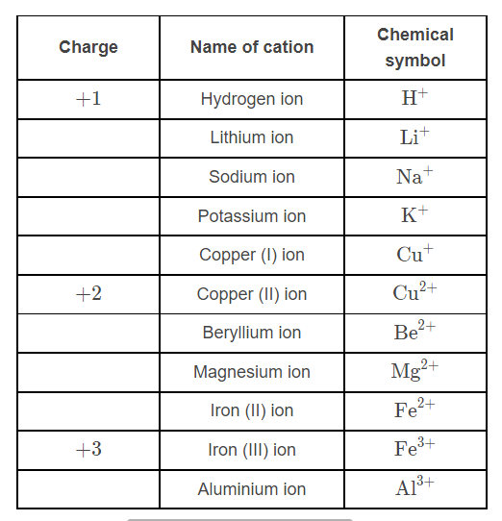
Here are some examples of common cations that you will come across in your studies.
Note that hydrogen is a non-metal atom that forms a cation (H+). It is very important in acid-base chemistry!

Slide 23
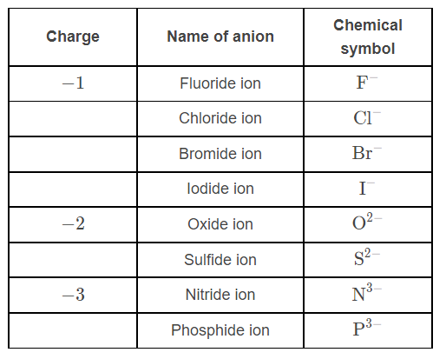
Here are some examples of common anions that you will come across in your studies.

Slide 24


Slide 25
Ionic Substances

Slide 26
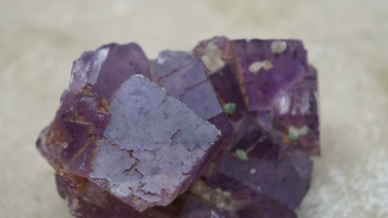
Welcome to this Smart Lesson about ionic substances. After you have completed this lesson, you should be able to:
Explain how and why ions form, in terms of electron configuration.
Describe the nature of ionic bonding.
Discuss the crystal lattice structure of solid ionic substances.
Determine the formulae and names of ionic compounds.

Slide 27
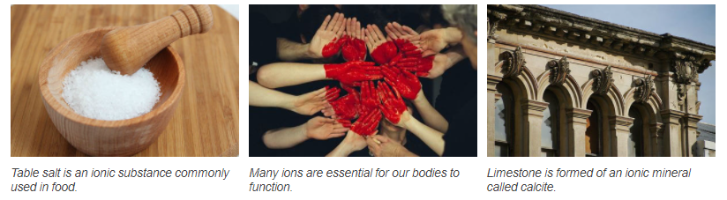
Ionic substances are everywhere in nature.
Many common substances are ionic compounds, including some of the rocks that make up the ground beneath your feet, and a lot of the things you use in everyday life.
Many ions are essential for our bodies to function; they facilitate the transmission of signals through the body and help maintain the functions of cells.

Slide 28
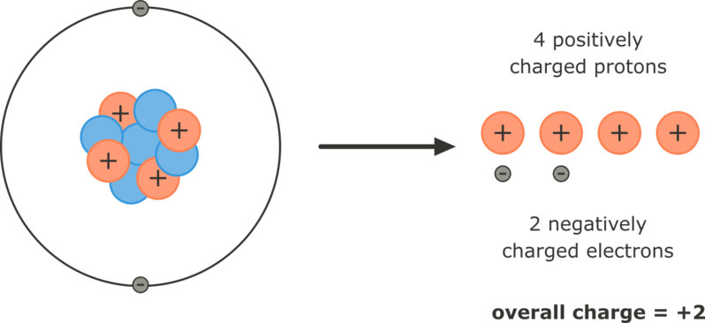
Ions form as a way for atoms to achieve greater stability.
Atoms are most stable when they have a full valence electron shell, and they may lose or gain electrons to attain this stability. An atom which has lost or gained electrons is called an ion.
In atoms, the number of positive protons and negative electrons are the same, so their charges cancel out and the atom has a neutral charge overall. In ions, these numbers are no longer balanced, so the ion has an overall electrical charge.
The beryllium atom loses two electrons to make an ion with four protons and two electrons, giving it an overall charge of +2.

Slide 29
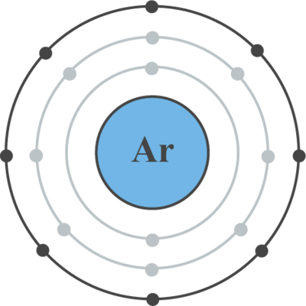
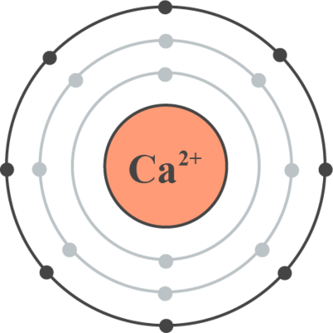
Filling Valence Shells
An atom will generally lose or gain the minimum number of electrons necessary to attain a full valence shell. The electron configuration of the ion will thus be the same as that of the nearest noble gas (which do not form ions because they already have full valence shells).
You can work out which ion an atom will form from its atomic number; this denotes the number of protons, and therefore the number of electrons in a neutral atom. From the atomic number you can work out the atom’s electron configuration, and thus the number of valence electrons.
Remember, the maximum number of electrons the first shell can hold is 2; the second shell can hold 8, and the third shell can hold 18 (though it is stable with 8).

Slide 30
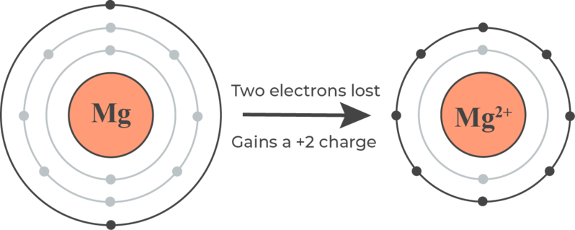
Cations and Anions
For atoms where the valence shell is less than half full, it takes less energy to lose those few electrons than to gain many. These atoms will lose all of the electrons from their valence shells, to form a positively charged cation.
For atoms where the valence shell is more than half full, it takes less energy to gain a few electrons than to lose many. These atoms will gain enough electrons to fill their valence shell, and form a negatively charged anion.
A quick way to remember that cations are positive is that cats have paws and paws are pawsitive.

Slide 31
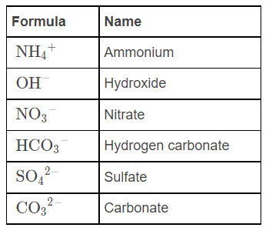
Polyatomic ions are charged particles made up of groups of atoms.
They are covalently bonded together, so they act as a single unit when in an ionic compound. This means that their charge is associated with the whole group of atoms that make up the polyatomic ion.
The names and formulae of the polyatomic ions you will need to know are listed below.

Slide 32
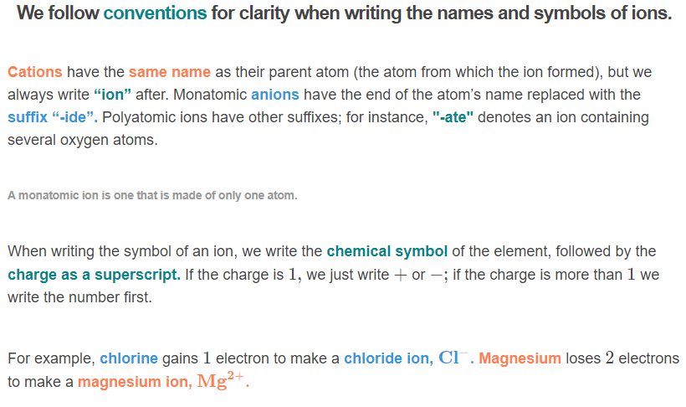

Slide 33
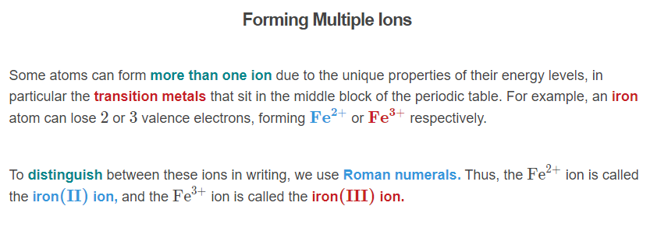
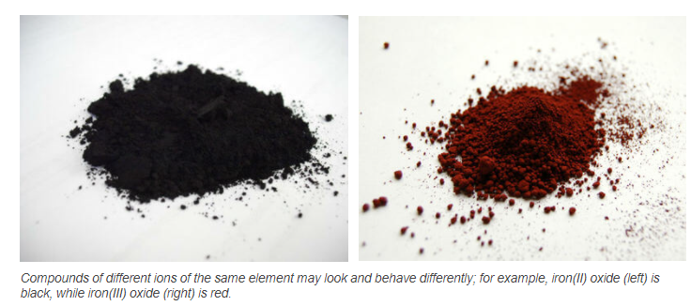

Slide 34
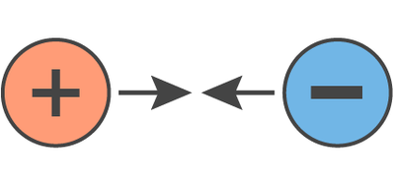
Atoms do not lose or gain electrons out of nowhere.
When an atom that needs to lose electrons meets an atom that needs to gain electrons, they will exchange the required electrons.
The two atoms become a positively charged cation and a negatively charged anion, which are electrostatically attracted to each other.

Slide 35
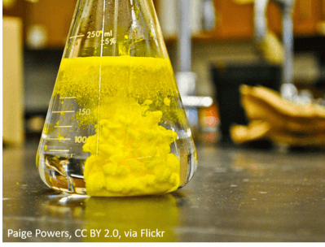
The strong electrostatic forces between cation and anion form an ionic bond.
Electrostatic forces are the attractive forces between electrically charged objects. Opposite charges attract each other strongly, while like charges repel; this is why the oppositely charged ions bond together.
As metal atoms commonly need to lose electrons and non-metal atoms commonly need to gain them, ionic bonds usually form between a metal cation and a non-metal anion.

Slide 36
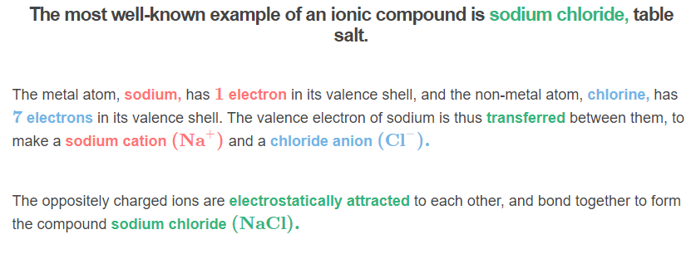
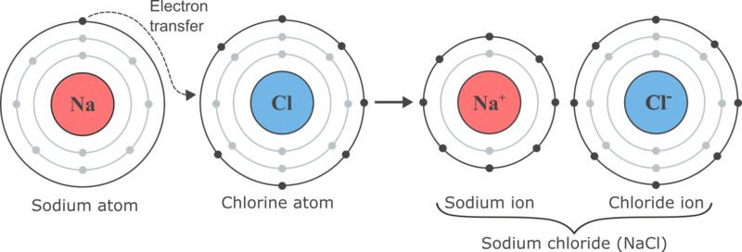

Slide 37
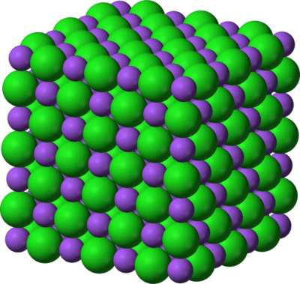
Ionic bonds do not form between two individual ions.
Instead, they form lattices of cations and anions known as ionic compounds. These lattices involve a repeated three-dimensional arrangement of ions, which are neutral overall because the charges of the ions cancel out.

Slide 38
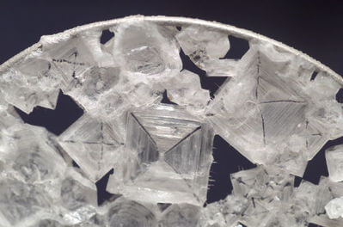
The Structure of Ionic Compounds
In an ionic compound, each ion is surrounded by a group of oppositely charged ions to form a stable lattice structure. Each cation is strongly attracted to the surrounding anions, and vice versa.
The ions pack together in the way that will form the most stable possible arrangement, with oppositely charged ions as close together as possible.

Slide 39

Ionic compounds are always neutral overall. The charges of the cations and anions must cancel each other out.
If the charges on the ions have the same magnitude, as in sodium chloride, the crystal lattice will form with equal numbers of cations and anions.
If the charges on the ions are not the same, there will be more of one ion than the other, so that the compound remains neutral overall.

Slide 40
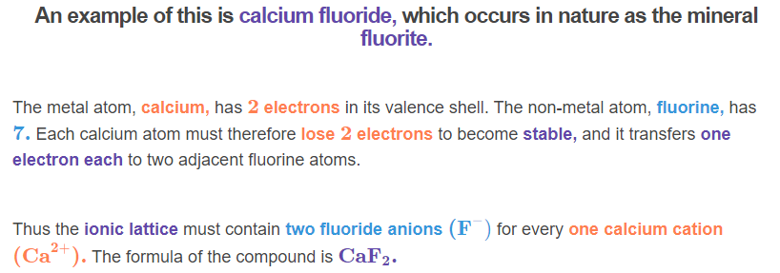
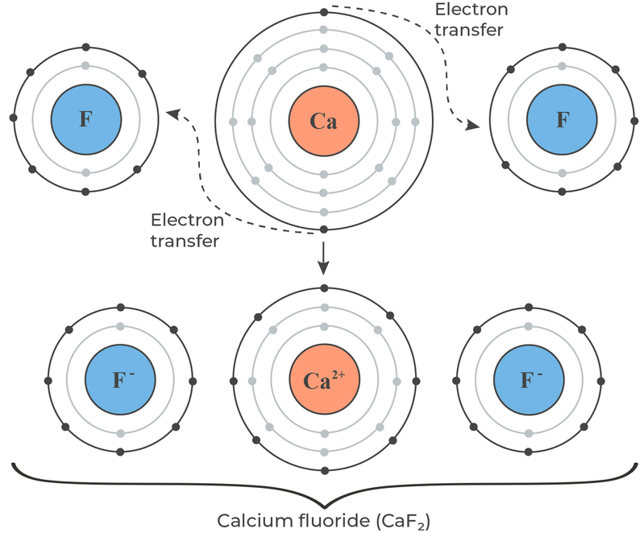

Slide 41
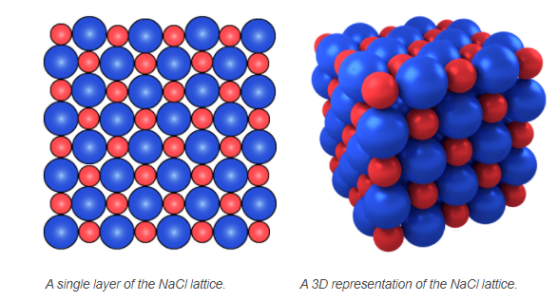
We can visualise how ions pack together within the ionic lattice by imagining them as spheres.
Imagine first a single layer of a sodium chloride crystal. Every Na+ ion is surrounded by Cl− ions, and vice versa. Each ion is surrounded by 4 ions of the opposite charge. Now, place an identical layer on top and another on the bottom, such that no identical ions touch each other. This means that each ion is surrounded by 6 oppositely charged ions. This is the 3-D arrangement of sodium chloride, and it repeats throughout the entire structure.
Other ionic compounds may have different structures. The proportions of each ion needed for a neutral compound influences how they pack together, as does the size of the ions involved.

Slide 42
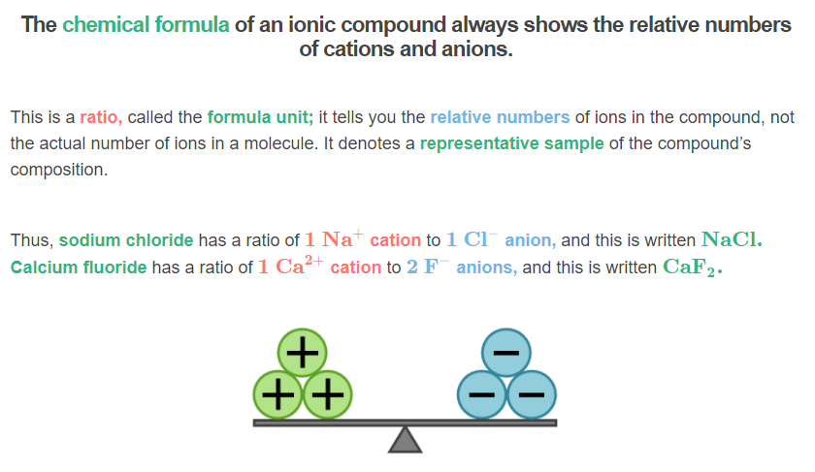

Slide 43
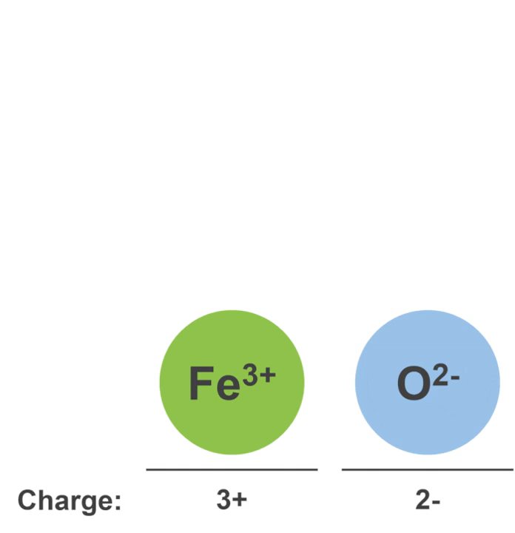
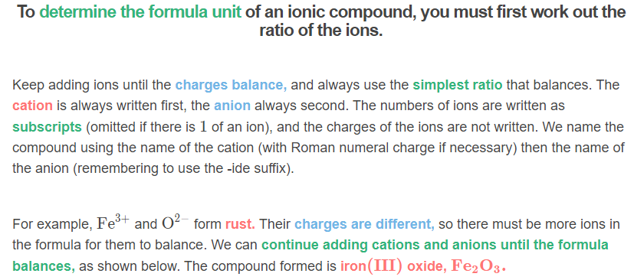

Slide 44
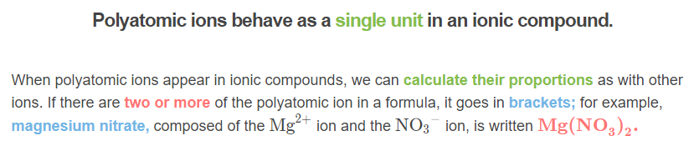
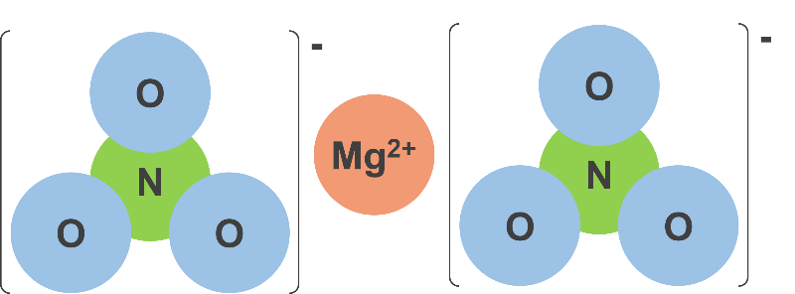

Slide 45
Physical Properties of Ionic Substances

Slide 46
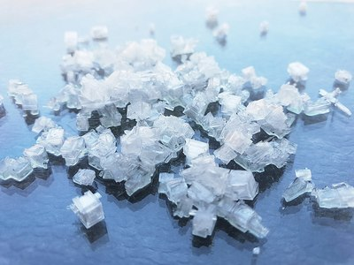
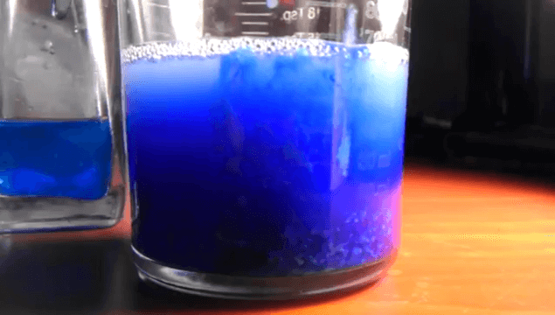
Welcome to this Smart Lesson about the physical properties of ionic substances. After you have completed this lesson, you should be able to:
Explain the physical properties of ionic substances.
Identify some uses of ionic compounds, and how these relate to their properties.

Slide 47
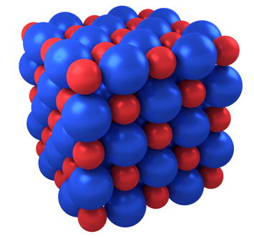
The physical properties of ionic substances can be explained by the way that ionic bonding occurs.
Ionic compounds are crystalline solids, with distinct crystal structures, due to their repeating pattern of ions in a three-dimensional lattice structure. Strong electrostatic forces of attraction hold the ions together.

Slide 48
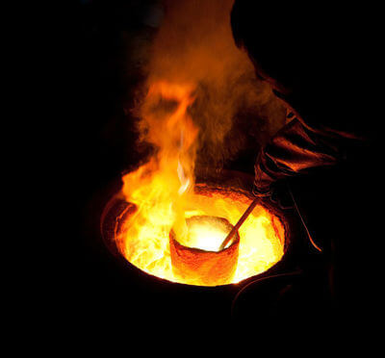
Ionic substances have high melting and boiling points.
This is because the strong electrostatic forces of attraction between the ions take a large input of energy to overcome.
Applying heat causes the particles to vibrate (as heat energy is converted to kinetic energy); a great enough input of heat energy will start to overcome the attractive forces between particles. When some attractions are overcome, melting occurs, and when all attractions are overcome, boiling occurs.

Slide 49

Ionic substances are hard.
They are hard because the strong electrostatic forces hold the ions in a rigid lattice, closely packed.
Just as it takes a lot of heat energy to melt an ionic solid, it takes a lot of kinetic energy to scratch or break them. Every ion is strongly bonded to each of the oppositely charged ions surrounding it, so ionic solids can resist large amounts of force in multiple directions.

Slide 50
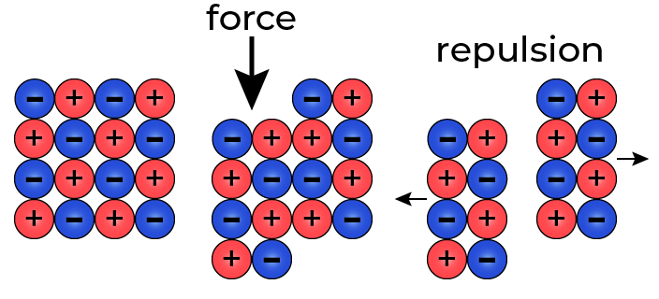
However, ionic substances are also brittle.
If you try to distort the crystal, the ions will move so that ions with the same charges are adjacent. These will repel each other, and the lattice will fracture. It takes a lot of energy to do this, but when the breaking point is reached it will happen suddenly.
Along the plane of the crystal lattice (i.e. along the rows of ions), ionic substances have good cleavage; a sharp blow in these directions will result in a clean split producing a smooth surface. A sharp blow along a different plane will cause the lattice to shatter.
Cleavage is the tendency of a substance to break along flat planes in the crystal structure.

Slide 51
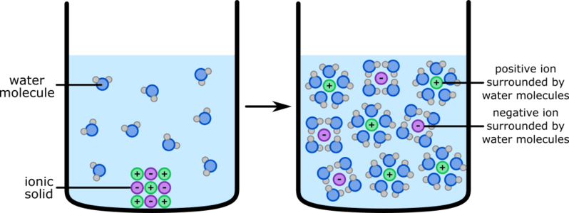
Ionic substances are soluble in polar solvents.
Liquids that are made up of polar molecules (where each molecule has a permanent uneven distribution of charge) are polar solvents. The best known example is water (H2​O), where the hydrogen atoms have a partial positive charge and the oxygen atoms have a partial negative charge.
As polar solvents have these uneven charges, they will attract the charged ions, and the solvent-solute attractive forces will be strong enough to overcome the solute-solute attractive forces. Thus the solvent will separate ions from the ionic lattice, causing the ionic solid to dissolve. A non-polar solvent will not attract the ions, so the solute-solvent attractive forces are not strong enough to overcome the solute-solute attractive forces, and the ionic solid will not dissolve.

Slide 52
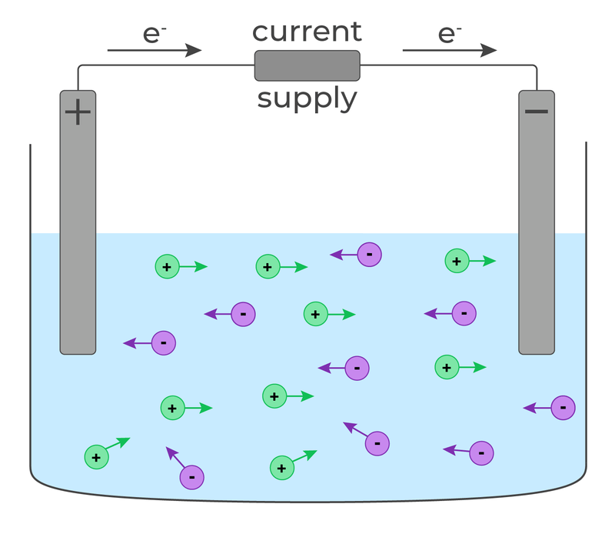
Electrical conductivity requires charged particles that are able to move freely.
Ionic substances are not conductive when they are solid, as the ions are bound in fixed positions within the ionic lattice.
However, when they are molten or dissolved, the ions are free to move. Thus, ionic substances are conductive in this state.

Slide 53

Many ionic compounds are useful in everyday life.
The physical properties we have discussed, as well as various chemical properties, govern how they are used. These chemical properties are related to the fact that ionic compounds are soluble in water, allowing the properties of the constituent ions to be used when they’re dissolved.

Slide 54
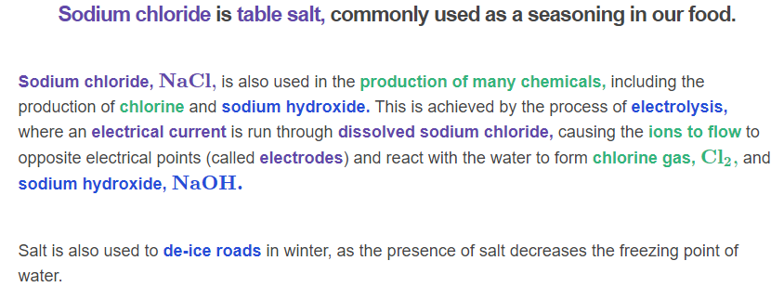


Slide 55


Slide 56



Slide 57



Slide 58
Naming Ionic Compounds

Slide 59

By the end of this lesson you should be able to:
1. | Write the chemical names of ionic compounds.
2. | Write the chemical formulae of ionic compounds.

